Slide 1
16/07/25 CS Lesson

Slide 2
Today’s Objectives
Understand how if, elif and else statements are used
Understand how for loops and while loops are used
Learn the structure and purpose of functions and procedures
Practise using functions and procedures

Slide 3
If, Elif and Else Statements
If, elif and else statements are used to execute different blocks of code based on whether a given condition is true or false. Essentially, it’s used when the program needs to make decisions to respond to different situations.
if checks the first condition.
elif (else if) checks additional conditions if the previous ones are false.
else runs if none of the above conditions are true.
Example:
1: age = int(input(“Enter age…”))
2:
3: if age >= 18:
4: print(“You are an adult.”)
5: else:
6: print(“You are not an adult.”)
Questions:
What is the condition in this example?
What block of code executes when the condition is true?
What block of code executes when the condition is false?
What does this code do?

Slide 4
If, Elif and Else Statements
If, elif and else statements are used to execute different blocks of code based on whether a given condition is true or false. Essentially, it’s used when the program needs to make decisions to respond to different situations.
Example:
1: age = int(input(“Enter age…”))
2:
3: if age >= 18:
4: print(“You are an adult.”)
5: else:
6: print(“You are not an adult.”)
Questions:
What is the condition in this example?
What block of code executes when the condition is true?
What block of code executes when the condition is false?
What does this code do?

Slide 5
For Loops
For loops are used when you want to iterate a section of code a set amount of times, preventing the need to write the same line multiple times.
For loops will always have a variable, which is used to know when the loop will end, based of a condition. This variable can be any datatype, however it is generally an integer (typically denoted as ‘i’ or ‘j’ if it’s a nested for loop).
Example:
1: summation = 0
2:
3: for i in range(1, 11, 1): # the parameters are (start, end, step)
4: summation += i
5: print(summation)
Questions:
What line of code executes when ‘i’ is 5?
What line of code executes when ‘i’ is 11?
What does this code do?
Notes:
Answers: 1) 4 2) 5 3) sum from 1 to 10 (Σ10)

Slide 6
While Loops
Compared to for loops, while loops are used to iterate a section of code indefinitely (forever) based on the whether the condition is met or not. This is useful for when you don’t know how many times you need to iterate that section of code (e.g. entering passwords).
Example:
1: num = 7
2:
3: while num % 4 != 0:
4: num += 7
5: print(num)
Questions:
What is the condition of the while loop?
How many times will line 4 run?
What will the example output?
What does this code do?
Notes:
Answers: 1) num % 4 != 0 2) 3 3) 28 4) Finds the first multiple of 7 which a multiple of 4.

Slide 7
Functions and Procedures
A function is basically a reusable block of code that performs a specific task and returns a value.
Function Example:
1: def Square(x):
2: return x * x
3:
4: five = Square(5)
5:
6: print(five)
7: print(Square(2))
Questions:
What is the value of the variable ‘five’?
What is the output?
Function
Square(x)
Input: x
Output: x * x
Notes:
For everytime the function is called, the program comes back to lines 1 and 2 and substitutes x with, for example, 5 like in line 4.

Slide 8
Functions and Procedures
A function is basically a reusable block of code that performs a specific task and returns a value.
Function Example:
1: def Square(x):
2: return x * x
3:
4: five = Square(5)
5:
6: print(five)
7: print(Square(2))
Questions:
What is the value of the variable ‘five’?
What is the output?
Function
Square(5)
Input: 5
Output: 5 * 5
Notes:
For everytime the function is called, the program comes back to lines 1 and 2 and substitutes x with, for example, 5 like in line 4.

Slide 9
Functions and Procedures
What can be written inside a function can be anything as long as it performs that specific task.
The placeholders for values that you pass into a function are called parameters (there can be no parameters if they’re not needed).
Local variables that are defined inside a function can only exist inside of that function and cannot be used elsewhere in the program.
Functions can be called multiple times within the program.
Function Example:
1: def add_numbers(a, b):
2: result = a + b
3: return result
4:
5: print(add_numbers(1, 2))
6: print(add_numbers(8, 9))
7: print(add_numbers(2, 5))
In this example there is a function labelled ‘add_numbers’ that takes in two parameters (‘a’ and ‘b’).
'result' is a local variable defined inside the function thus cannot be used elsewhere in the program.
As you can see in lines 5-7, the function is called multiple times.

Slide 10
Functions and Procedures
Procedures are exactly the same as functions; however, they do not return a value, they only perform the action.
Procedure Example:
1: def Greet(name):
2: print("Hello " + name)
3:
4: Greet(“Mr Berne”)
Questions:
What is the output?
Notes:
Explain the difference between Greet(“Mr Berne”) and Print(Greet(“Mr Berne”)) in line 4.

Slide 11
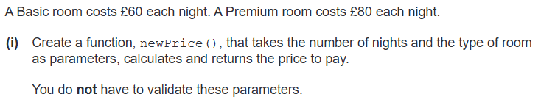

Functions and Procedures
WE DO:

Slide 12
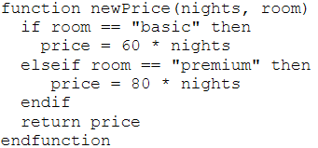
Functions and Procedures
WE DO:

Slide 13


Functions and Procedures
YOU DO:
Create a function, labelled CircleArea(), that takes the radius of the circle as a parameter, calculates and returns the area of the circle.
Area of Circle = πr² with π as 3.14

Slide 14
Functions and Procedures
YOU DO:
Create a function, labelled CircleArea(), that takes the radius of the circle as a parameter, calculates and returns the area of the circle.
Area of Circle = πr² with π as 3.14
Answer:
1: def CircleArea(radius):
2: area = 3.14*(radius**2)
3: return area

